Slide 1
NASTTPO Conference April 2023
Legal, Regulatory, Litigation Updates
Timothy Gablehouse
tgablehouse@gcgllc.com

Slide 2
IAFC/PHMSA HAZMAT ROUNDTABLE REPORT
Detailed 2021/2022 & May 2023 (planned) meetings
Broad Federal participation.
Reports on the USB drives
Interesting findings:
LEPCs should focus on All-Hazards planning
LEPCs should not do free-standing hazmat plans.
Instead:
Integrate into local all-hazards plan
Many LEPCs are already the core of the all-hazards planning

Slide 3
Roundtable observations
KEYS TO SUCCESS
Local-based strategic planning - identify, prioritize, fill capability gaps.
Emphasize community awareness and involving public
LEPCs/TEPCs are critical in developing assessments.
Pursue community-based strategic planning to prioritize and fill capability gaps.
Measure Success!

Slide 4
CRIMINAL ENFORCEMENT
Criminal charges and bigger fines more common
Higher expectations of accident prevention
Arkema and Intercontinental Terminals
Reckless assault
Federal charges against Midwest Grain Products and Harcros
Knowing & Negligence Releases Under The Clean Air Act

Slide 5
CRIMINAL ENFORCEMENT - 2
PG&E Guilty For Reckless Maintenance Of Power Lines
Fines and Probation
In 2022 Judge Finds That They Violated Probation
More fines and threatened jail time
Paid $ millions to escape more charges
Aghorn Operating Inc. and VP indicted for H²S release & OSHA crimes in an incident with two deaths.
CSB Video

Slide 6
FLINT WATER – Criminal Charges
Nine City and State employees indicted: (reckless behavior)
Two Former City of Flint Emergency Managers
Former Director of the City of Flint Dept of Public Works
Former Governor of Michigan
Former Director, MI Dept of Health and Human Services
Former Chief Medical Executive, MI Dept of Health
Largely dismissed 12/22 on procedural grounds. Grand Jury meeting again.

Slide 7
FLINT WATER – Civil Claims
GOVERNMENT EMPLOYEES CAN BE SUED
Employees negligently/recklessly responded
EPA employee’s reassurances were negligent/reckless
CIVIL CLAIMS AGAINST EPA ALSO SUSTAINED
Failed to address imminent hazards
Failed to adequately “supervise” State agency’s actions

Slide 8
FLINT WATER – Civil Claims - 2
STATE EMPLOYEES CAN BE SUED
Officials and employees were alleged to be reckless
Governor, department heads and individual employees
Pled 5th amendment to avoid depositions & testimony
INVERSE CONDEMNATION CLAIMS
State environment & health agencies, Governor and City

Slide 9
CHEMICAL RELEASE FINES
Georgia nitrogen release kills six
Total fines of over $1MM
Facility operating the refrigeration system
Company that cleaned the equipment
Company that built & serviced the system
Deliberate indifference –
Safety manager position unfilled
Criminal investigation underway

Slide 10
OTHER LITIGATION
CAFO Rule Cases Still Pending
EPA will Issue New Regulatory Proposal Momentarily
US Steel Release Reporting Under CERCLA
Permitted Release Exempt Even When Permit Violated
Clean Air Council v US Steel, 51 ELR 20116, 3d Cir., June 21, 2021.
Still Consequences
Over $600,000 fines, release notification commitments
Political consequences – permit shield being removed
Failure to enforce permit alleged civil rights violation

Slide 11
EPCRA LITIGATION
Dep't of Labor & Indus. v. Heltzel, (Pa.)
EPCRA “preempts” state open records rules
PublicSource v. Pa. Dep't of Labor & Indus., (W.D. Pa.)
EPCRA requires Tier II information request to specify the facility
Californians for Renewable Energy et al. v. U.S. EPA et al., 4:15-cv-03292, ND CA
Environmental justice issues include the potential for accidental releases

Slide 12
SUING SERCs & LEPCs
No EPCRA suit against LEPC or host Government
Sue the SERC
2018 BL 373743, 86 ERC 2870, (DNJ Oct. 9, 2018)
Very limited citizen suit provisions under EPCRA

Slide 13
SERCs, LEPCs & CIVIL RIGHTS
SERCs & local governments can be defendants
Being an LEPC member is not a shield
Some states provide immunity for state claims
A civil rights claim of inadequate emergency planning could be based on LEPC plan
Having free-standing LEPC plans increases risk of civil rights & ADA suits!

Slide 14
CIVIL RIGHTS & EJ LITIGATION
EPA imposed $1.2 MM fine mandatory improvements on Valero for RMP violations
EPA used CAA emergency authority to mandate emissions cuts regardless of permits in minority neighborhood
San Antonio sued over planning to reduce vulnerabilities under the ADA
Louisiana suit banning racially and religiously discriminatory land-use system.

Slide 15
REGULATORY ACTIONS
WORST CASE SPILL PREVENTION REGULATIONS
Final Rule by the end of the year ~
CAFO – Final EPCRA exemption rule
Will be revised momentarily
RMP – Final RMP Rule Issued
Revised version proposed
Chemical Safety Board Reporting Rule/Form adopted
Guidance available at csb.gov

Slide 16
CWA WORST CASE PROPOSAL
APPLICATION
onshore nontransportation-related facilities
“that could reasonably be expected to cause substantial harm to the environment by discharging CWA hazardous substances”

Slide 17
NASTTPO COMMENTS
Add 294 CWA haz substances to “list-of-lists”
Reduce the proposed thresholds
SERCs may designate facilities
Potential for harm to 1st responders to be a criteria triggering planning requirements

Slide 18
MORE NASTTPO COMMENTS
Mandate ICS training for “qualified individual”
Improved coordination requirements
Mandate compliance with ASTM E3241-20
Automatic sharing of plans with LEPCs and responders
Exercises if requested by LEPCs, EM or responders

Slide 19
PRESSURE ON EPA TO EXPAND RMP
Emphasis on EJ Issues
April 14, 2022 Letter from Members of Congress
“Common sense emergency response measures, such as back-up power, leak detection, and real-time air monitoring, along with broad and accessible information access – such as multilingual outreach before an incident occurs – should be included.”

Slide 20
AND THAT’S WHAT EPA DID
“Safer Communities by Chemical Accident Prevention”
Information upon request to anyone within 6-miles in the language preferred by the requestor.
Requires safer technologies
Greater employee participation & third-party audits
Risks of natural hazards, climate change, loss of power.
Coordination and exercises
Facility siting addressed in hazard reviews.

Slide 21
EPA Retail Fertilizer Exemption Guidance
EPCRA section 311(e)(5) exempts retailers from reporting when held for sale to the ultimate customer (farmer who applies the fertilizer).
The Exemption does not apply to:
Fertilizers mixed or blended with other things
Other chemicals that are used or stored on site

Slide 22
THE NEXT BIG THINGS
PFAS
Bans and product substitution risks
Burning ammonia with coal
Failure to manage change
Maintenance cycles to climate change
New information sources – fenceline monitoring
Civil Rights & Environmental Justice

Slide 23
CPG 101 Ver. 3.0
There is a Civil Right to Emergency Planning
“State and local governments must comply ADA in emergency- and disaster-related programs” ¹
“planners must comply with Title VI of the Civil Rights Act, and other federal, state or local anti-discrimination laws.”
“In the nation’s system of emergency management, the local government acts first to address the public’s emergency needs. … At a minimum, these measures include priorities such as warning, emergency public information, evacuation, shelter, security, emergency medical care and tactical communications.”
¹Look at ada.gov to understand the magnitude of the mandate.

Slide 24
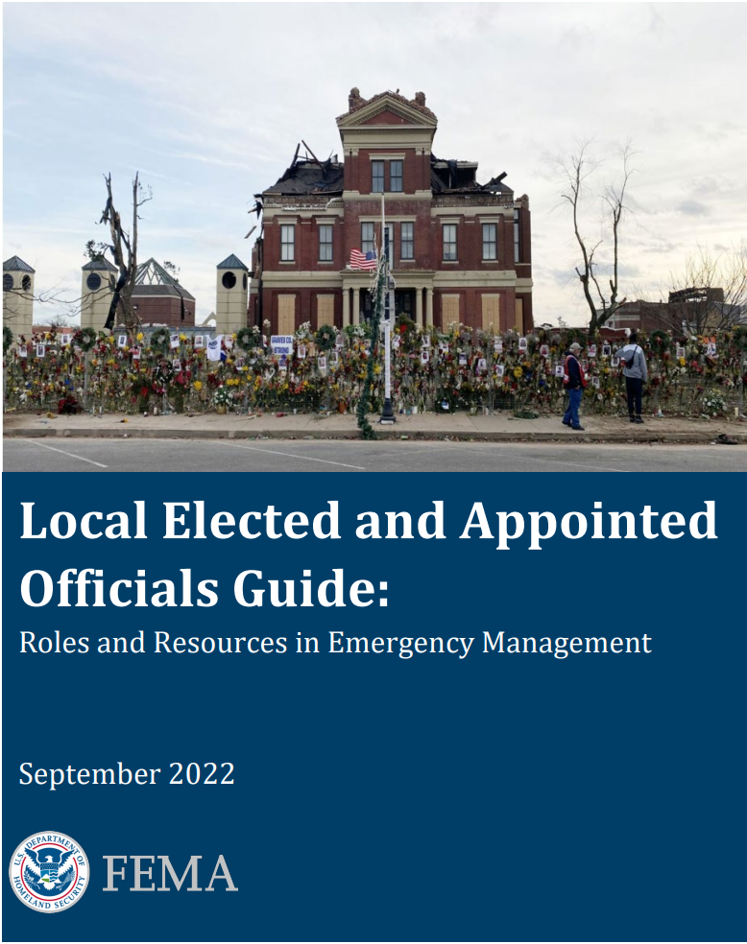
Local Officials Guide
Senior officials are responsible to develop and maintain partnerships with those most affected by disasters.
Individuals with disabilities are protected by the ADA for services and activities provided by state and local governments and third parties.
A “One-Size-Fits-All” approach to planning, resourcing and information dissemination does not work.
Establish a core planning team with … representatives from among people with access and functional needs;
Integrating people with access and functional needs through public outreach in plans, trainings and exercises;
Key Message:
Support equitable and comprehensive disaster preparedness, response and recovery.

Slide 25
EPA EJ ACTION PLAN
[I]ncorporate an EJ function and staffing support within the Incident Management Team and Emergency Operations Center structures ….
[E]nsure that EJ issues are addressed in a timely manner and briefed to the Incident Command/Unified Command ….
[D]evelop public participation guidelines for disaster response situations… _________________________________________________________
EJ is a key aspect of any regulatory compliance program involving emergency preparedness.
- RMP rule.
Key Message:
Ensuring compliance … with … civil rights laws … including Title VI of the Civil Rights Act ….

Slide 26
CLIMATE CHANGE RISKS FOR CHEMICAL RELEASES
EPA, CSB, FEMA, UN, OTHERS
“NaTech” disasters - natural hazard caused releases
Regulatory actions - more than CWA or RMP changes
ENFORCEMENT & CRIMINAL PROSECUTIONS
Extreme weather should be anticipated - negligent or reckless disregard of the hazard and failure to prepare
NASTTPO guidance document for LEPCs

Slide 27
EPA EXPECTATIONS – CLIMATE CHANGE
FINES VS PROSECUTION FOR RELEASES
Extreme weather events should be anticipated
Shut down procedures power loss & flooding
Safety procedures for power loss & flooding
Employees are trained on procedures
Review release reporting requirements
Coordination with LEPCs & Responders
ASTM Standard E3241

Slide 28
AVOIDING CIVIL RIGHTS CLAIMS
Understand the risks locally
Realistically understand capabilities
Whole community not just response
Communicate/educated to create realistic expectations
Prevention/response/mitigation

Slide 29
Strategic Planning and Measuring Success As a Defense
Honor your community conditions & priorities - develop a vision of success
Strategic plan to fill capability gaps
Prioritize with community participation
Measure results
Progress on the strategic plan is success in planning

Slide 30
Measure Success as a Defense
UNEP Guidance
https://www.sia-toolbox.net/file/unep-apell-handbook-2015pdf
EPA’s Measuring Success Document
http://www.epa.gov/sites/production/files/2013-08/documents/measuring_progress_lepc.pdf

Slide 31
CONTACT
Timothy Gablehouse
tgablehouse@att.net or tgablehouse@gcgllc.com
303.572.0050
Let me know if you want to be on the email list or want documents.

